Slide 1
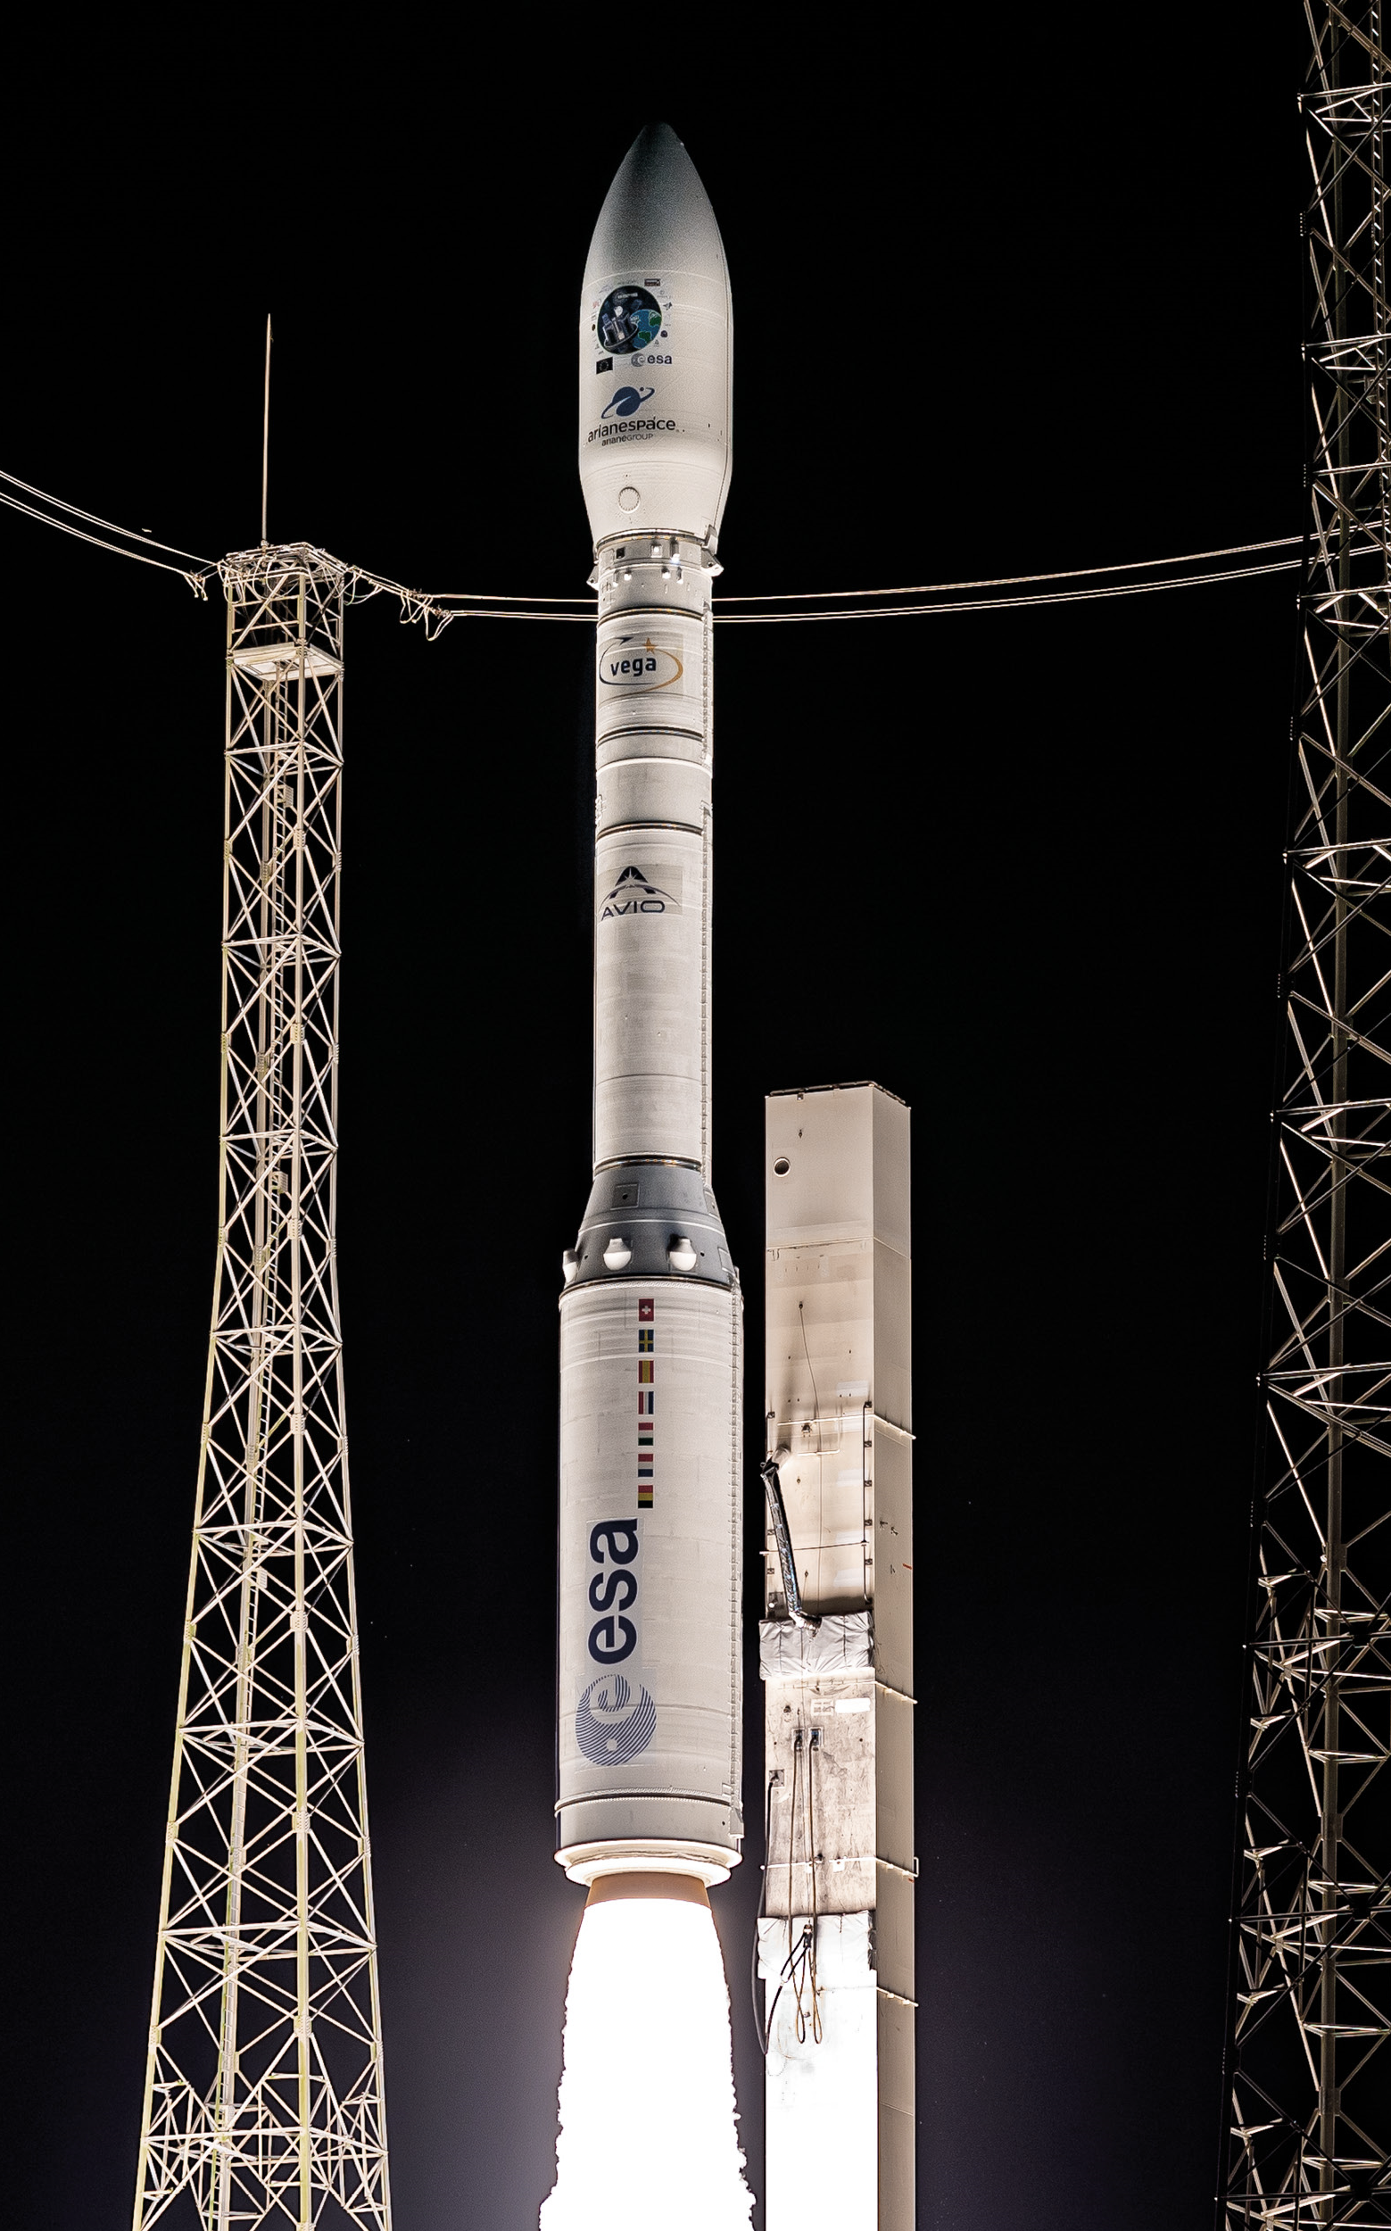

POLITECNICO DI TORINO
Bachelor’s Degree in Aerospace Engineering
Academic Year – 2021/22
Numerical simulation of the regression in a star grain solid rocket motor
Tutor:
Ing. Andrea Ferrero
Candidate:
Davide Roversi

Slide 2
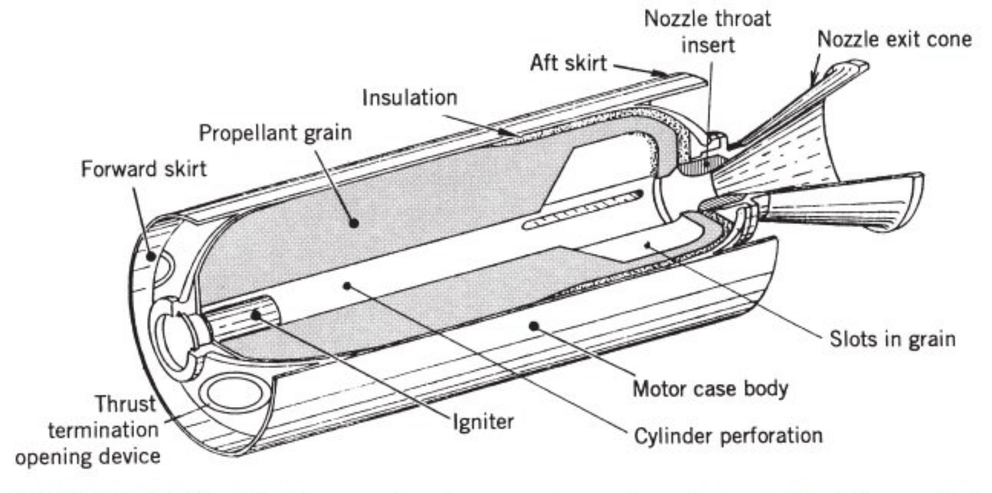
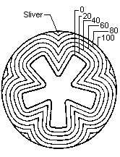
Expected results:
Combustion surfaces trend with time;
Comparison between numerical and analytical methods;
Thrust-time curve;
Motor total impulse.

Slide 3
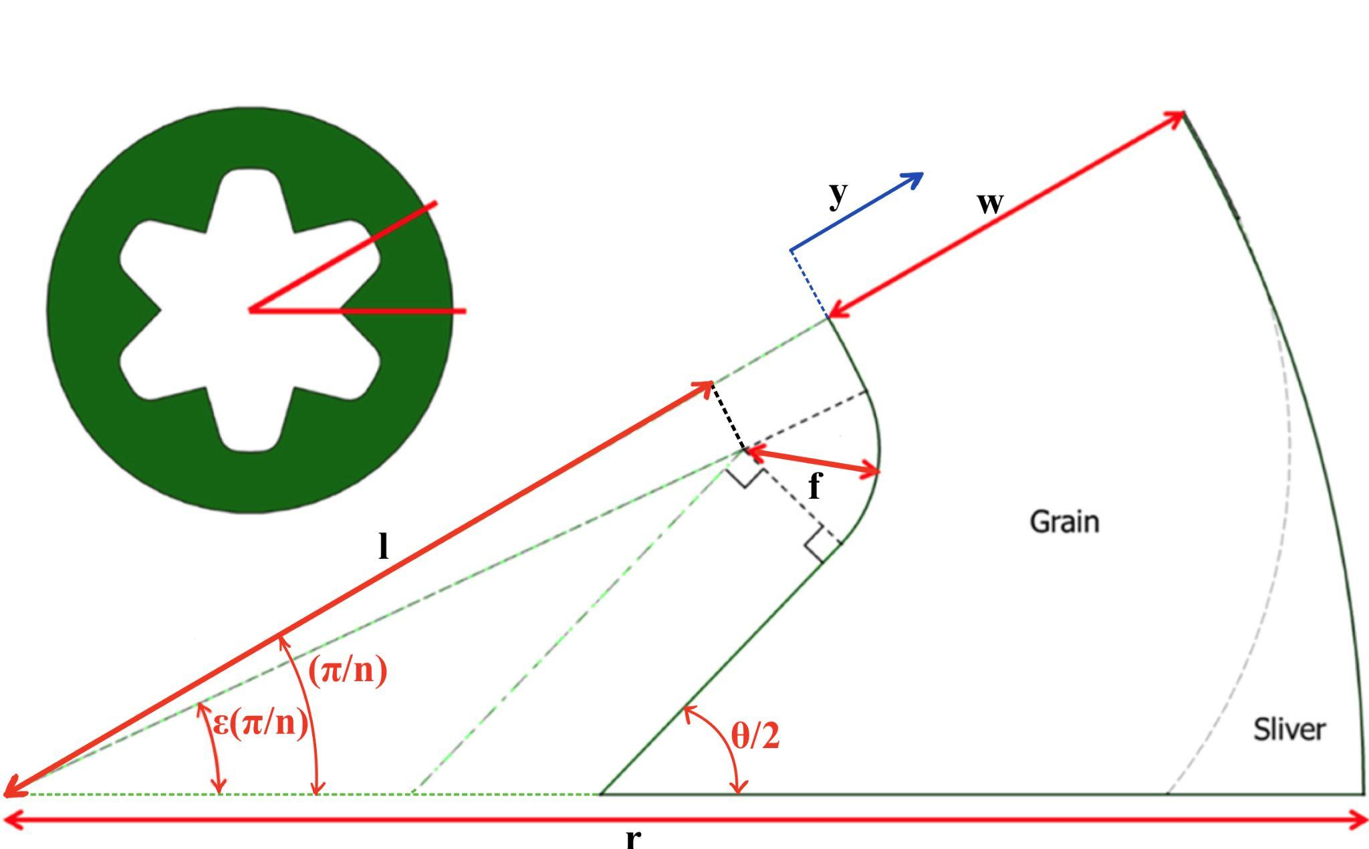
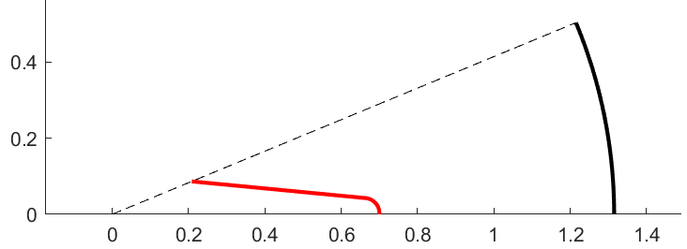
Hypotheses:
Uniform grain section and composition along main axis;
0D model equations in the combustion chamber;
Combustion as succession of equilibrium states.
Input data:
Grain geometry;
Physical and chemical properties of propellant;
Combustion chamber temperature;
Nozzle geometry.

Slide 4
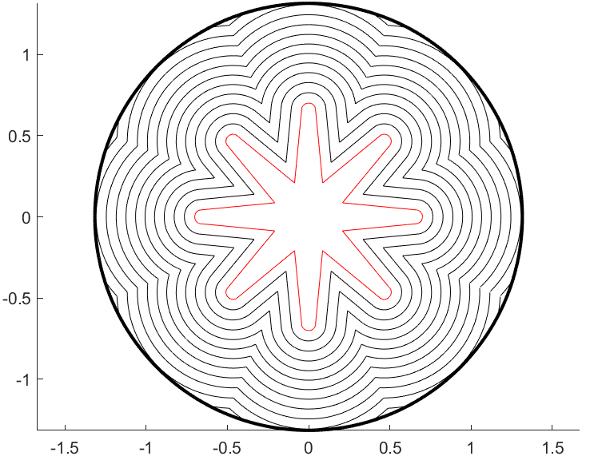
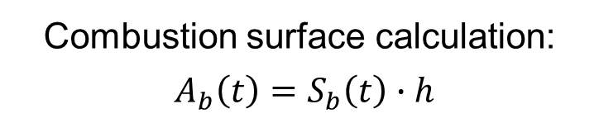
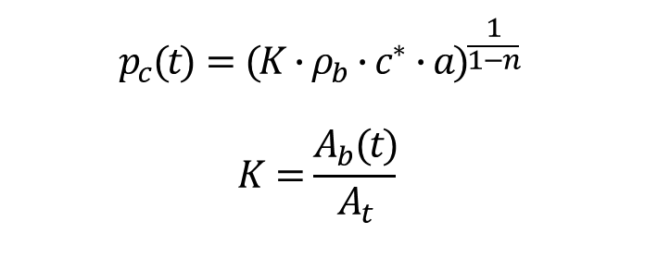
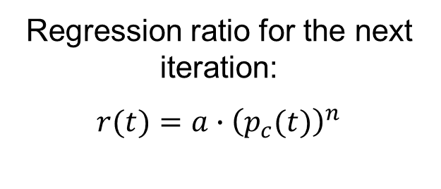
Main iterative cycle:
Combustion surface calculation:
$A_{b}\left(t\right)=S_{b}\left(t\right)∙h$
Combustion chamber pressure:
$$p_{c}(t)=(K∙ρ_{b}∙c^{∗}∙{a)}^{\frac{1}{1−n}}$$
$$K=\frac{A_{b}(t)}{A_{t}}$$
Surfaces regression:
Regression ratio for the next iteration:
$$r(t)=a∙{\left(p_{c}(t)\right)}^{n}$$

Slide 5
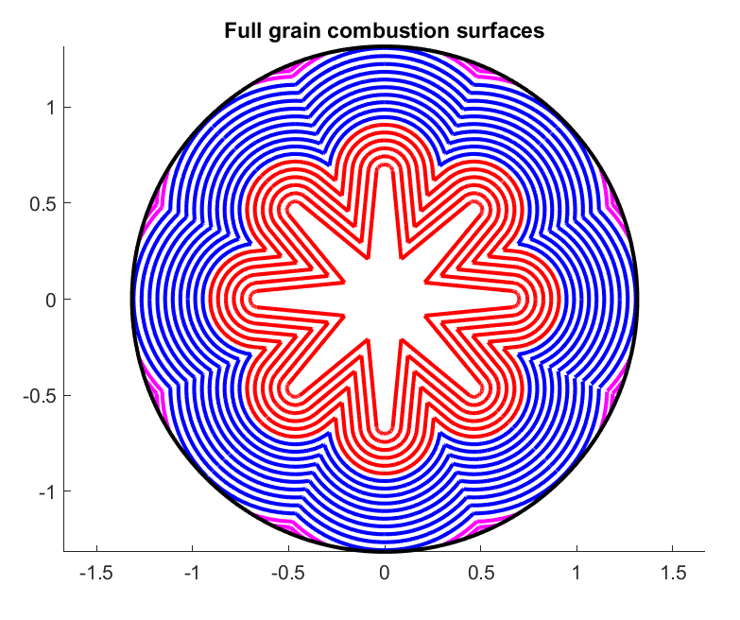
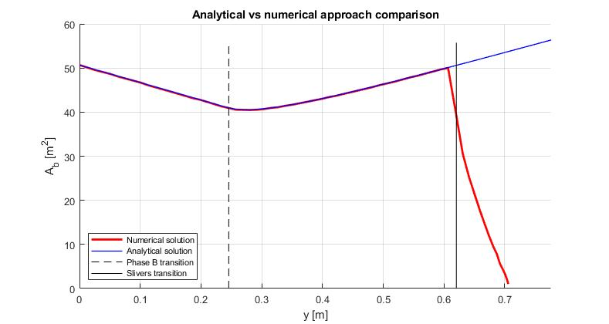
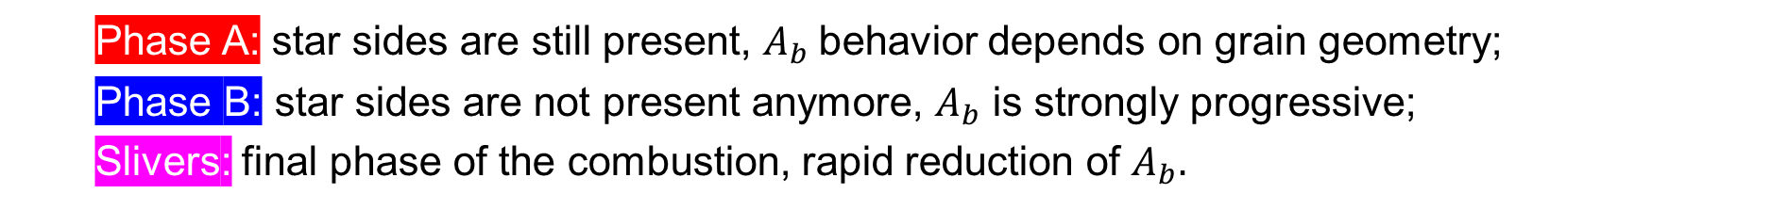
Combustion phases:
Phase A: star sides are still present, $A_{b}$behavior depends on grain geometry;
Phase B: star sides are not present anymore, $A_{b}$ is strongly progressive;
Slivers: final phase of the combustion, rapid reduction of $A_{b}.$

Slide 6
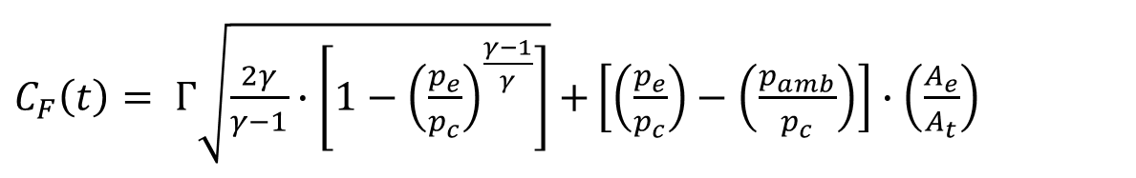
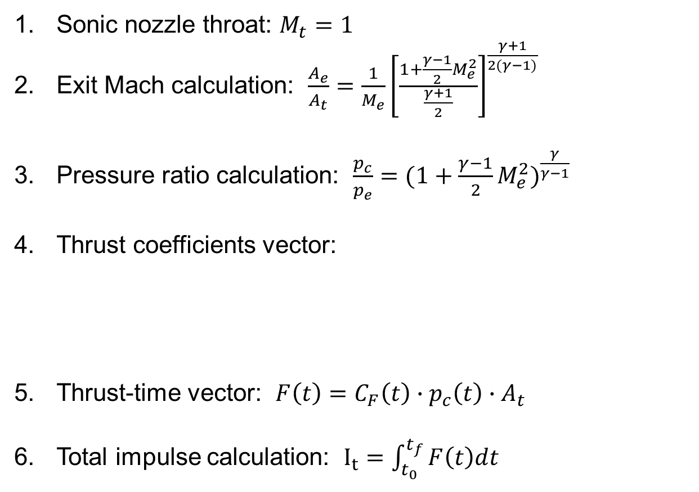
From chamber pressure to thrust:
Sonic nozzle throat: $M_{t}=1$
Exit Mach calculation: $\frac{A_{e}}{A_{t}}=\frac{1}{M_{e}}{\left[\frac{1+\frac{γ−1}{2}M_{e}^{2}}{\frac{γ+1}{2}}\right]}^{\frac{γ+1}{2(γ−1)}}$
Pressure ratio calculation: $\frac{p_{c}}{p_{e}}={(1+\frac{γ−1}{2}M_{e}^{2})}^{\frac{γ}{γ−1}}$
Thrust coefficients vector:
Thrust-time vector: $F\left(t\right)=C_{F}\left(t\right)∙p_{c}\left(t\right)∙A_{t}$
Total impulse calculation: $I_{t}=\int_{t_{0}}^{t_{f}}{F\left(t\right)dt }$
$C_{F}\left(t\right)= Γ\sqrt{\frac{2γ}{γ−1}∙\left[1−{\left(\frac{p_{e}}{p_{c}}\right)}^{\frac{γ−1}{γ}}\right]}$ $+\left[\left(\frac{p_{e}}{p_{c}}\right)−\left(\frac{p_{amb}}{p_{c}}\right)\right]∙\left(\frac{A_{e}}{A_{t}}\right)$

Slide 7
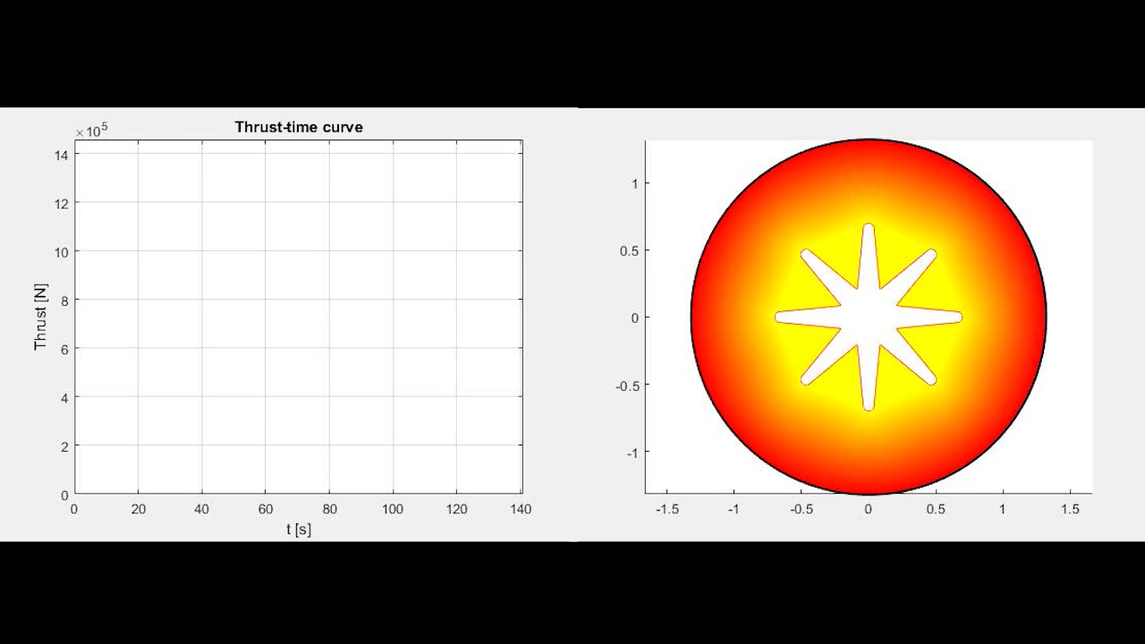
First phase is regressive, second phase is progressive: variable thrust behavior is not desirable.
Possibility to modify grain geometry to obtain a neutral burning grain.

Slide 8
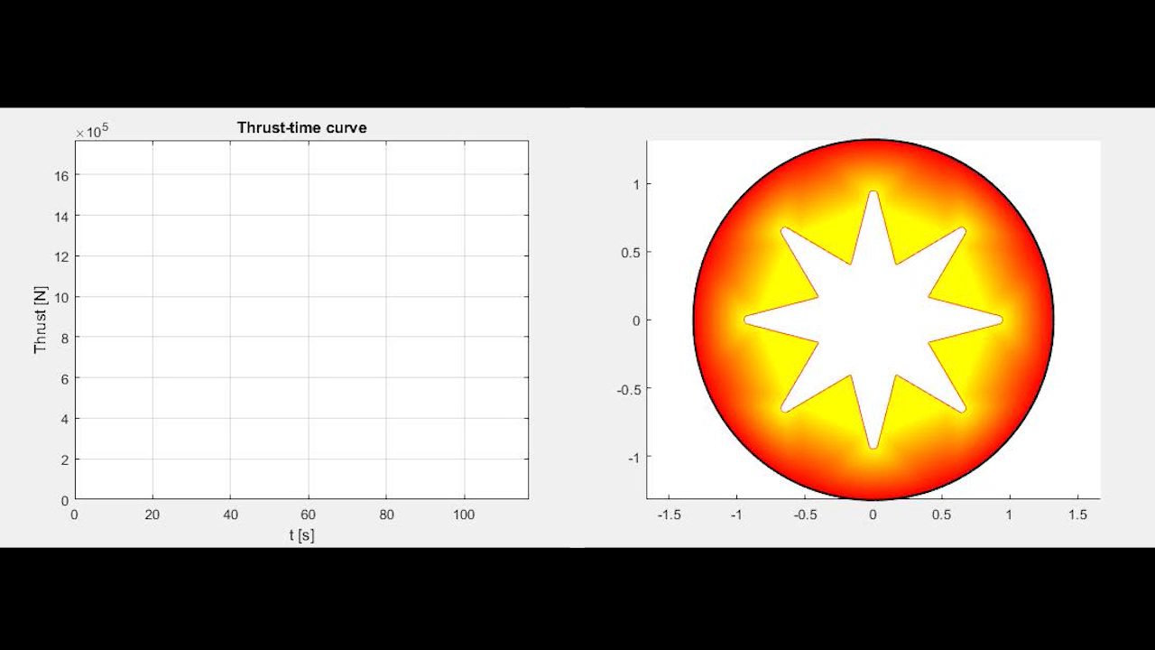
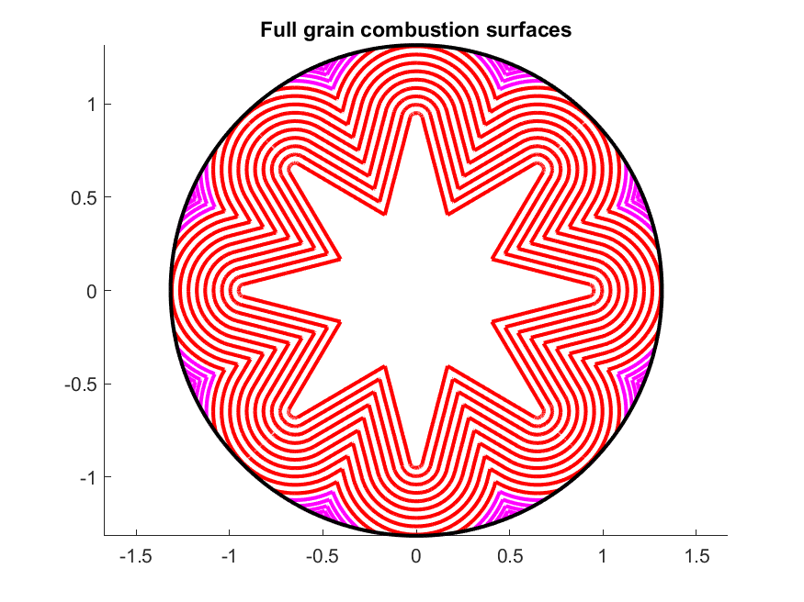
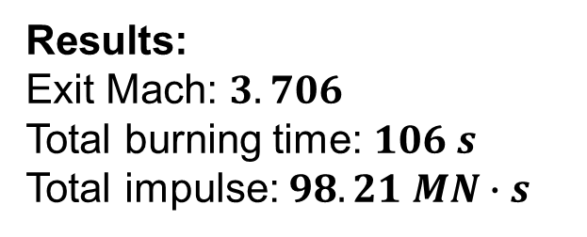
Phase A is neutral, phase B is not present.
Constant thrust.
Results:
Exit Mach: $3.706$
Total burning time: $106 s$
Total impulse: $98.21 MN∙s$

Slide 9
Conclusions:
The correctness of the numerical method has been validated by the analytical approach;
The numerical method returns a valid solution even in the last phase of the combustion;
Numerical approaches are generally more flexible, allowing for a wider range of simulation cases;
The main limitations of the code are:
Assumption of a grain with constant composition and density;
Assumpion of a constant section along the axis;
Simplifications deriving from the 0D combustion chamber model.
The accuracy of the results could be increased by using models that take into account gas and grain inhomogeneities, imperfect combustion or boundary layer effects in the nozzle.

Slide 10
Thanks for your attention

